Slide 1


Welcome TO QUANTITATIVE APTITUDE & REASONING DIVISION
QUANT &
REASONING

Slide 2

PROBLEM SOLVING SKILLS-I (21UC3105)
Q AND R DIVISION (C.S.S. DEPARTMENT)

Slide 3
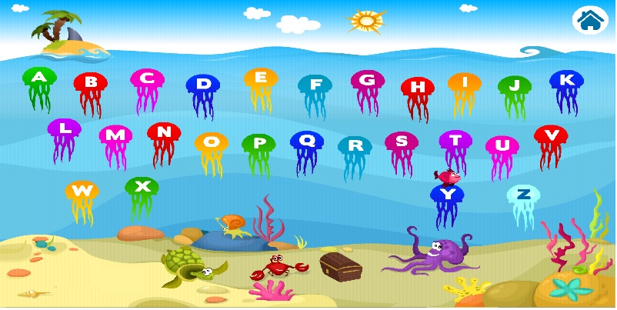
NUMBER - LETTER SERIES & ANALOGY
Q AND R DIVISION (C.S.S. DEPARTMENT)

Slide 4
NUMBER SERIES
We will classify Number Series into the following categories
Difference series
Product series
Squares/Cubes series
Miscellaneous series
Combination series
Q AND R DIVISION (C.S.S. DEPARTMENT)

Slide 5
NUMBER SERIES
Difference Series: The difference series can be further classified into
Number series with constant difference
Ex: 1, 4, 7, 10, 13 ........
Number series with increasing or decreasing difference
Ex: 2, 3, 5, 8, 12, 17, 23,.........
Product Series:
Ex: 2, 4, 8, 16, 32, 64........
Here, each number in the series is multiplied by 2 to get the next term.
Q AND R DIVISION (C.S.S. DEPARTMENT)

Slide 6
NUMBER SERIES
Miscellaneous series:
There are series that do not come under the other patterns and are of general nature but are important and are fairly common. Even here, sometimes, there can be a specific pattern in some cases.
Take the series 3, 5, 7, 11, 13 ...this is the series of PRIMES NUMBERS. It is an important series and the student should look out for this as one of the patterns. The next term in this series is 17.
Take the series 9, 25, 49, 121 ....In this series, the terms are SQUARES of prime numbers . Hence, the next term is 13^2 , i.e., 169.

Slide 7
NUMBER SERIES
Combination series:
A number series which has more than one type of (arithmetic) operation performed or more than one series combined together is a combination series .
Ex: Consider the series 2, 6, 10, 3, 9, 13, 4, 12, ..........
Here, the first term 2 is multiplied by 3 to get the second term, and 4 is added to get the third term.
The next term is 3(one more than the first term 2) and it is multiplied by 3 to get 9 (which is the next term )and then 4 is added to get the next term 13.The next term 4(which is one more than 3)which is multiplied with 3 to get 12, the next term. Then 4 is added to this to get the next number 16.

Slide 8
NUMBER SERIES
1. 41, 43, 40, 45, 38, 49, 36, ?, 34
a. 51 b. 53 c. 57 d. 55

Slide 9
NUMBER SERIES
2. Find the missing number in the series: 4, 18, ?, 100, 180, 294, 448.
a. 48 b. 36 c. 81 d. 25

Slide 10
NUMBER SERIES
3. 5824, 5242, ?, 4247, 3823
a. 4467 b. 4718 c. 4856 d. 5164

Slide 11
NUMBER SERIES
4. 3, 5, 5, 19, 7, 41, 9, ?
a. 71 b. 61 c. 79 d. 69

Slide 12
NUMBER SERIES
5. What is the next number in the series: 21, 77, 165, 285, ?
a. 404 b. 415 c. 426 d. 437

Slide 13
LETTER SERIES
6. WFB, TGD, QHG, ?
a. NIJ b. NIK c. NJK d. OIK

Slide 14
LETTER SERIES
7. Z, S, W, O, T, K, Q, G, ?, ?
a. N, C b. N, D c. O, C d. O, D

Slide 15
LETTER SERIES
8. Z, X, S, I, R, R, ?, ?
a. G, I b. J, I c. J,K d. K,M

Slide 16
LETTER SERIES
9. A, B, B, D, C, F, D; H, E, ?, ?
a. E, F b. F, G c. F, I d. J, F

Slide 17
NUMBER AND LETTER ANALOGY
Analogy means correspondence.
In question based on analogy, a particular relationship is given, and another similar relation ship has to be identified from the alternatives provided.

Slide 18
NUMBER AND LETTER ANALOGY
10. 47 : 121 :: 89 : ________
a. 183 b. 187 c. 193 d. 195

Slide 19
NUMBER AND LETTER ANALOGY
11. 5 : 20 :: 8 : _______
a. 52 b. 54 c. 56 d. 58

Slide 20
NUMBER AND LETTER ANALOG
12. 13 : 221 ::19 :_______
a.443 b. 450 c. 420 d. 437

Slide 21
NUMBER AND LETTER ANALOGY
13. 9 : 0.111 :: 4:_______
a. 0.5 b. 0.3 c. 0.35 d. 0.25

Slide 22
NUMBER AND LETTER ANALOGY
14. 28 : 60 :: 59:_______
a. 42 b. 46 c. 76 d. 56

Slide 23
NUMBER AND LETTER ANALOGY
15. 29 : 23 :: 43 ______
a. 37 b. 31 c. 39 d. 41

Slide 24
NUMBER AND LETTER ANALOGY
16. 248 : 1090 : : ________ : 1029
a. 366 b. 377 c. 562 d. 287

Slide 25
NUMBER AND LETTER ANALOGY
17. 208 : 1010 : : ________ : 1130
a. 366 b. 377 c. 567 d. 763

Slide 26
NUMBER AND LETTER ANALOGY
18. 49 : 169 : : _______ : 100
a. 25 b. 85 c. 64 d. 36

Slide 27
NUMBER AND LETTER ANALOGY
19. 24 : 36 : : _______ : 121
a. 25 b. 85 c. 64 d. 36

Slide 28
NUMBER AND LETTER ANALOGY
20. KDSTF : OEUUI : : TYSEL : _______
a. UAUIO b. UUUIO c. UAAIO d. UAUOO

Slide 29
NUMBER AND LETTER ANALOGY
21. NATURE : PEVASI :: ISOMERS :_______
a. OTUNJTV b. OTUNIST c. PUVNJST d. OVTNJST

Slide 30
NUMBER AND LETTER ANALOGY
22. DELHI : EDMGJ : : COCHIN : ?
a. DODIKO b. BPBIHM c. DNDGJM d. BPBIJN

Slide 31
NUMBER AND LETTER ANALOGY
23. Hand : Fingers : : Leg : ________
a. Knuckles b. Knee c. Toes d. Heel

Slide 32
NUMBER AND LETTER ANALOGY
24. Nut : Shell : : Seed : _______
a. Plant b. Tree c. Fruit d. Sapling

Slide 33
NUMBER AND LETTER ANALOGY
25. Day : Night : : Spendthrift : _________
a. Rich b. Miser c. Poor d. Pauper

Slide 34
NUMBER AND LETTER ANALOGY
Answer Key
01. b | 02. a | 03. b | 04. a | 05. d | 06. b | 07. a | 08. a | 09. d | 10. b
11. c | 12. d | 13. d | 14. d | 15. a | 16. a | 17. d | 18. c | 19. d | 20. a
21. b | 22. c | 23. c | 24. c | 25. b

Slide 35


